Slide 1
Chapter 6 Design Principles
Principles of Interaction Design
Comprehensibility
Learnability
Effectiveness/Usefulness
Efficiency/Usability
Grouping
Stimulus Intensity
Proportion
Screen Complexity
Resolution/Closure
Usability Goals
1

Slide 2
Grouping
Low-level principles - used to make decisions about specific screen controls, menus and layouts
Use visual cues to support the logical structure of the interface
Gestalt Principles of Perception
  Gestalt psychology strives to explain the factors involved in the way we group things
  At the heart of Gestalt psychology is the idea that we strive to find the simplest solutions to incomplete visual information

Slide 3


Gestalt Principles of Perception
Figure-Ground: Basic premise
  We perceive our environment by differentiating between objects and their backgrounds
The Rubin Face/Vase Illusion
Mac Logo

Slide 4
Gestalt Principles of Perception
  Proximity
  Similarity
  Common Fate
  Closure
  Good Continuity
  Area
  Symmetry
  Surroundedness
  Prägnanz
You need to spend a bit of time reading this in the text book!

Slide 5
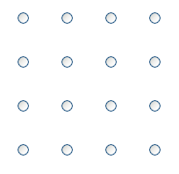
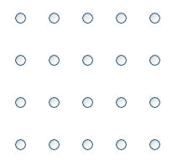
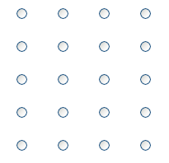
Gestalt Principles of Perception
Proximity Principle – Objects that are close to each other will be seen as belonging together
Equidistant | Horizontal Proximity | Vertical Proximity

Slide 6
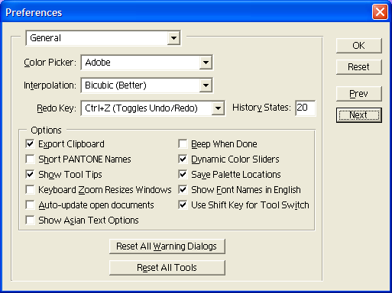
Gestalt Principles of Perception
Proximity - Adobe PhotoShop Preferences Dialog

Slide 7
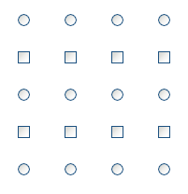
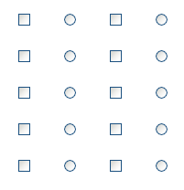
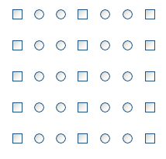
Gestalt Principles of Perception
Similarity Principle – Objects that have similar visual characteristics, such as size, shape or color will be seen as a group and therefore related
Rows of Similar Objects Columns of Similar Objects Grouped Columns

Slide 8
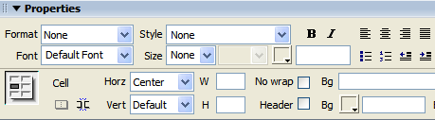
Gestalt Principles of Perception
Property Pane from Macromedia’s Dreamweaver
  Our eyes pick up all of the text boxes because of the strong blue squares and the white areas that they have in common

Slide 9
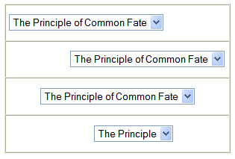
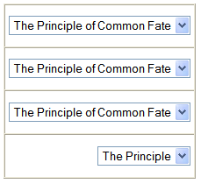
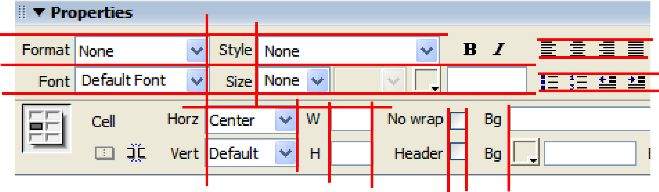
Gestalt Principles of Perception
Common Fate Principle – Objects that move together are seen as related
Unaligned Drop-Down Menus Aligned Drop-Down Menus

Slide 10

Gestalt Principles of Perception
Closure Principle – We tend to see things as complete objects even though there may be gaps in the shape of the objects
][ ][ ][
[ ] [ ] [ ] [

Slide 11


Gestalt Principles of Perception
Good Continuity Principle – We tend to see things as smooth, continuous representations rather than abrupt changes

Slide 12


Gestalt Principles of Perception
The Area Principle – Objects with small area tend to be seen as the figure, not the ground (also called the smallness principle)

Slide 13



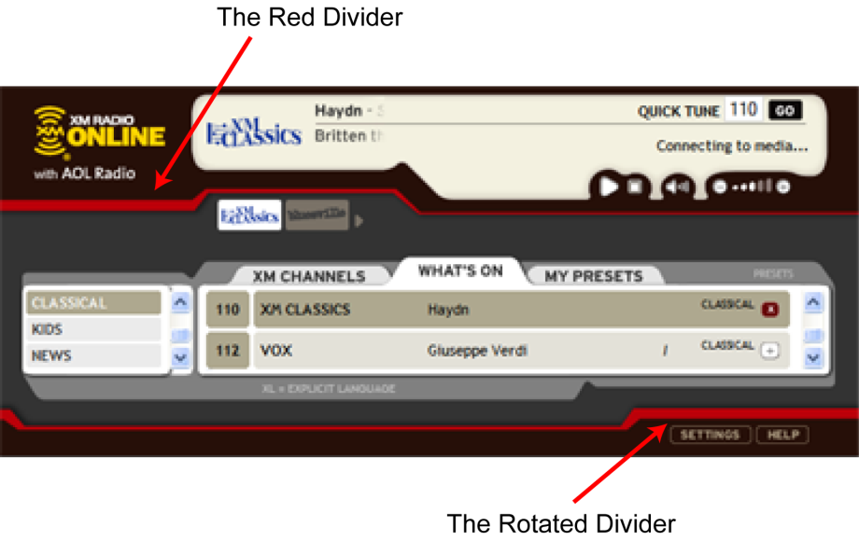
Gestalt Principles of Perception
Symmetry Principle – Symmetrical areas tend to be seen as complete figures that form around their middle
Translation Reflection Rotation

Slide 14
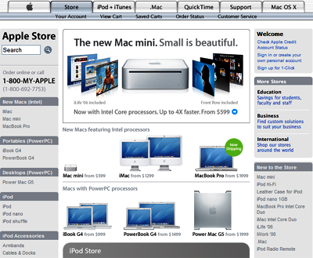

Gestalt Principles of Perception
Surroundedness Principle – An area that is surrounded will be seen as the figure and the area that surrounds will be seen as the ground

Slide 15
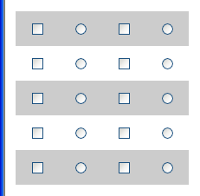
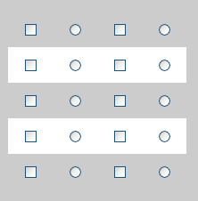
Gestalt Principles of Perception
Prägnanz Principle – We tend to perceive things based on the simplest and most stable or complete interpretation
Visual Conflict with Common Fate Visual Conflict with Surroundedness

Slide 16
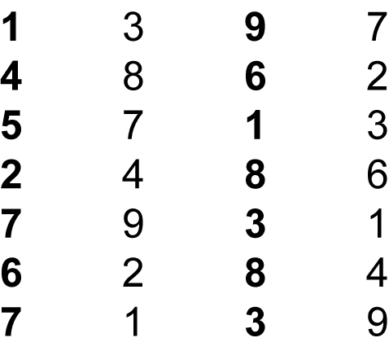
Other Principles of Perception - Stimulus Intensity
We respond first to the intensity of a stimulus and only then do we begin to process its meaning.

Slide 17
Other Principles of Perception – Proportion
Proportion can be used to represent logical hierarchies
Heading Level 1
Heading Level 2
Heading Level 3
Heading Level 4
Heading Level 5
Heading Level 6

Slide 18
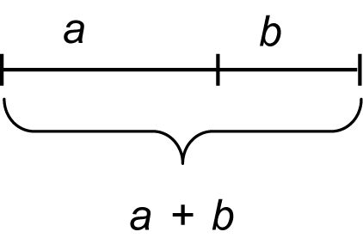
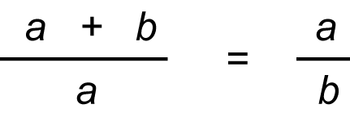
Other Principles of Perception – Proportion
Golden Ratio - The golden ratio expresses the relationship between two aspects of a form such as height to width and must equal 0.618

Slide 19
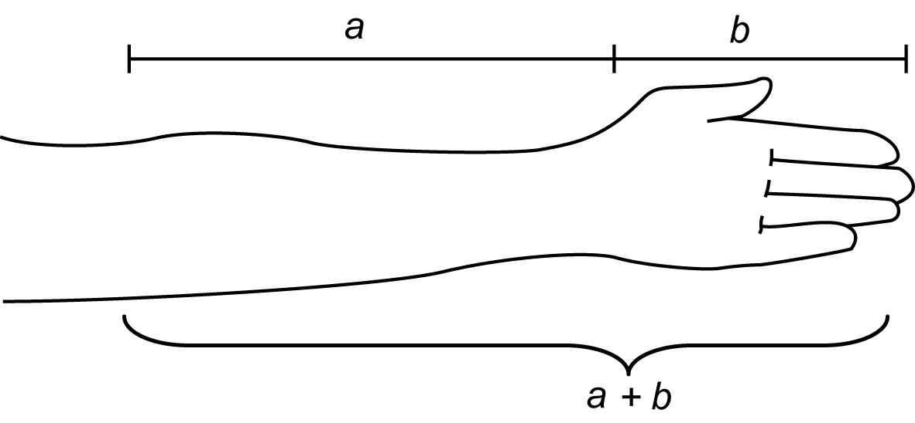
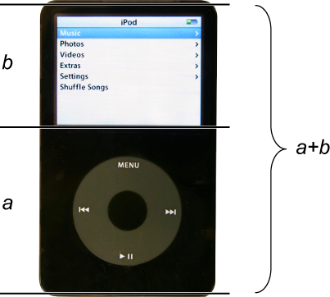
Other Principles of Perception – Proportion
Golden Ratio

Slide 20
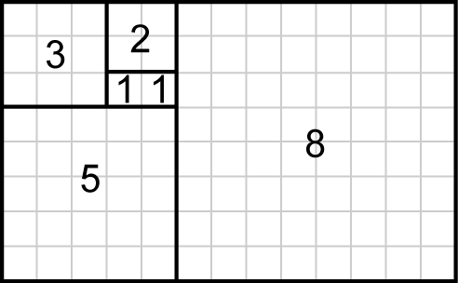
Other Principles of Perception – Proportion
Fibonacci - A sequence of numbers in which each number is the sum of the two preceding numbers.
  The relationship between the numbers in the Fibonacci series is similar to the golden ratio
1, 1, 2, 3, 5, 8, 13, 21, 34, 55, 89, 144, 233, 377, 610, 987, …

Slide 21
Other Principles of Perception - Screen Complexity
The measure of complexity developed by Tullis (1984) can be used to calculate the relative complexity, and therefore the difficulty, of a design. This measure of complexity uses information theory (Shannon & Weaver, 1949)
This is a fairly old theory – if you look back at screens of the 1980’s they were much simpler of those of today. What have designers done to counter complexity overload?

Slide 22
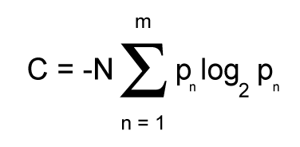
Other Principles of Perception - Screen Complexity
Formula for calculating the measure of complexity
C, complexity of the system in bits
N, total number of events (widths or heights)
m, number of event classes (number of unique widths or heights)
pn, probability of occurrence of the nth event class
(based on the frequency of events within that class)

Slide 23
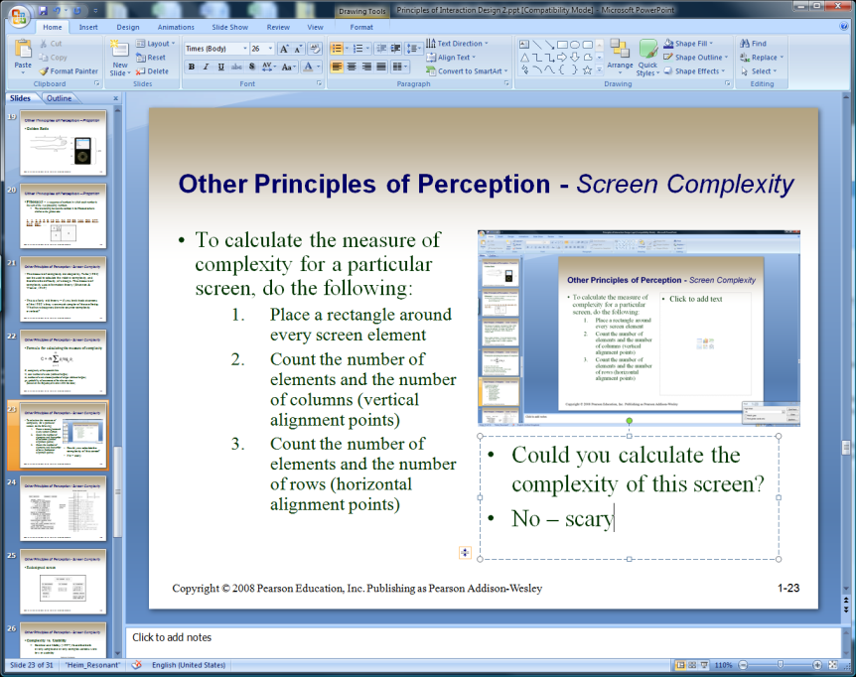
Other Principles of Perception - Screen Complexity
To calculate the measure of complexity for a particular screen, do the following:
  Place a rectangle around every screen element
  Count the number of elements and the number of columns (vertical alignment points)
  Count the number of elements and the number of rows (horizontal alignment points)
Could you calculate the complexity of this screen?
No – scary!!

Slide 24
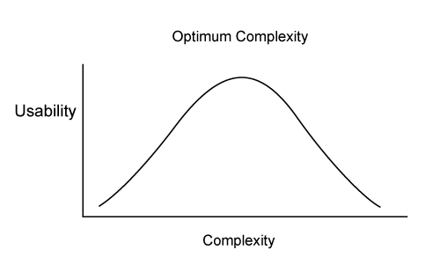
Other Principles of Perception - Screen Complexity
Complexity vs. Usability
  Comber and Maltby (1997) found that both overly simple and overly complex screens were low in usability
  They defined usability in terms of the following three components:
    Effectiveness
    Learnability
    Attitude

Slide 25
Other Principles of Perception - Screen Complexity
Comber and Maltby found tradeoffs between usability and complexity:
  As complexity decreased, predictability increased.
  As complexity decreased, it became harder to differentiate among screen objects; the screen became artificially regular.
  Decreased complexity meant that there were fewer ways to group objects.
  Excessive complexity made screens look artificially irregular.
  Increased complexity could occur from increased utility.

Slide 26
Usability Goals – Principles - Guidelines
Usability Goal—Easy to use
  Most people are interested in completing their tasks and do not enjoy struggling with the tools they need to use. One of the most important goals of user-centered design is to make things easy to use.
Design Principle—Simplicity
  Simple things require little effort and can often be accomplished without much thought. If interaction designs are guided by the principle of simplicity, they will be easier to use.
  Making the users task simple often requires more effort on the part of the designer and programmer

Slide 27
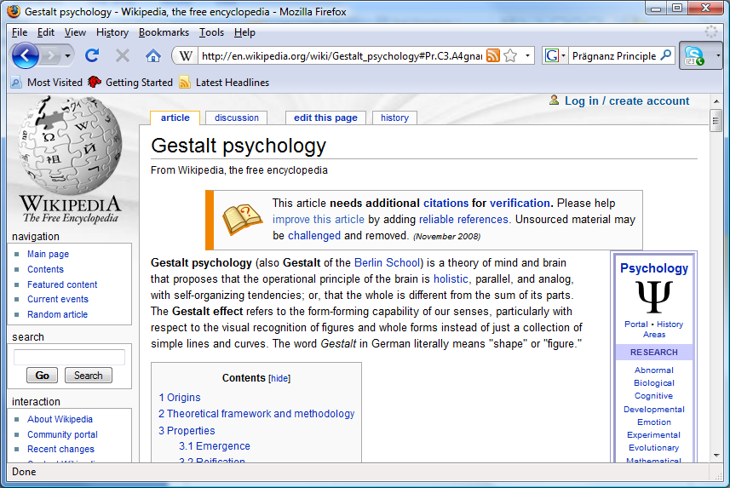
Questions
What Gestalt Principles of Perception can be illustrated from this screen shot?

